Slide 1
Database Management

Slide 2
Database
Database:
A collected information which is in an organized form for easier access, management, and various updating is known as a database.
A database is an organized collection of data, generally stored and accessed electronically from a computer system.
Where databases are more complex they are often developed using formal design and modeling techniques.

Slide 3
Database Management System
Database Management System:
Any system that manages databases is called a database management system, or DBMS.
The database management system (DBMS) is the software that interacts with end users, applications, and the database itself to capture and analyze the data.
Computer scientists may classify database-management systems according to the database models that they support

Slide 4
DBMS Functionalities
The functionality provided by a DBMS can vary enormously and should provide the functionalities like but limited to:
Data storage, retrieval and update
User accessible catalog or data dictionary
Support for transactions and concurrency
Facilities for recovering the database should it become damaged
Support for authorization of access and update of data
Access support from remote locations
Enforcing constraints to ensure data in the database abides by certain rules

Slide 5
Types of DBMS
Centralized Database:
The information(data) is stored at a centralized location and the users from different locations can access this data. This type of database contains application procedures that help the users to access the data even from a remote location.
Distributed Database:
With distributed DBMS, the data is not at one place and is distributed at various sites of an organization. These sites are connected to each other with the help of communication links which helps them to access the distributed data easily.
Personal Database:
Data is collected and stored on personal computers which is small and easily manageable. The data is generally used by the same department of an organization and is accessed by a small group of people.

Slide 6
Types of DBMS
End User Database
The end user is usually not concerned about the transaction or operations done at various levels and is only aware of the product which may be a software or an application. Therefore, this is a shared database which is specifically designed for the end user, just like different levels’ managers. Summary of whole information is collected in this database.
Commercial Database:
These are the paid versions of the huge databases designed uniquely for the users who want to access the information for help. These databases are subject specific, and one cannot afford to maintain such a huge information. Access to such databases is provided through commercial links.
Operational Database:
Information related to operations of an enterprise is stored inside this database. Functional lines like marketing, employee relations, customer service etc. require such kind of databases.

Slide 7
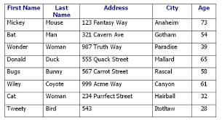
Important Terms
Table: In relational database terms, a table is responsible for storing data in the database. Database tables consist of rows and columns.

Slide 8
Important Terms
Field: Each piece of data in a table is stored in its location called “field”. For example, in previous table each entry has a field for first name, last name, address, city and age.
Record: One full set of field, that is all the related data about one person or object is called a “record”.
Rows: Rows run horizontally. They represent each record. A row is the smallest unit of data that can be inserted into a database.
Column: Columns run vertically. They contain the definition of each field. You give each column a name, so that it is describes the data that is stored

Slide 9
Entity–relationship model (ER model)
An Entity–relationship model (ER model) describes the structure of a database with the help of a diagram, which is known as Entity Relationship Diagram (ER Diagram).
An ER model is a design or blueprint of a database that can later be implemented as a database. The main components of E-R model are: entity set and relationship set.

Slide 10
Entity Relationship Diagram (ER Diagram)
An ER diagram shows the relationship among entity sets.
An entity set is a group of similar entities and these entities can have attributes.
In terms of DBMS, an entity is a table or attribute of a table in database, so by showing relationship among tables and their attributes, ER diagram shows the complete logical structure of a database.

Slide 11
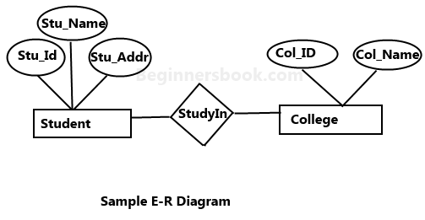
A simple ER Diagram
In the following diagram we have two entities Student and College and their relationship.
The relationship between Student and College is many to one as a college can have many students however a student cannot study in multiple colleges at the same time.
Student entity has attributes such as Stu_Id, Stu_Name & Stu_Addr and College entity has attributes such as Col_ID & Col_Name.

Slide 12
Advantages of Database
Ease of use: The revision of any information as tables consisting of rows and columns is much easier to understand .
Flexibility: Different tables from which information has to be linked and extracted can be easily manipulated.
Security: Security control and authorization can also be implemented more easily by moving sensitive attributes in a given table into a separate relation with its own authorization controls. If authorization requirement permits, a particular attribute could be joined back with others to enable full information retrieval.
Data Independence: Data independence is achieved more easily with normalization structure used in a relational database than in the more complicated tree or network structure.
Data Manipulation Language: The possibility of responding to query by means of a language based on relational algebra and relational calculus e.g. SQL is easy in the relational database approach. For data organized in other structure the query language either becomes complex or extremely limited in its capabilities.

Slide 13
Disadvantages of Database
Performance: A major constraint and therefore disadvantage in the use of relational database system is machine performance. If the number of tables between which relationships to be established are large and the tables themselves effect the performance in responding to the sql queries.
Physical Storage Consumption: With an interactive system, for example an operation like join would depend upon the physical storage also. It is, therefore common in relational databases to tune the databases and in such a case the physical data layout would be chosen so as to give good performance in the most frequently run operations. It therefore would naturally result in the fact that the lays frequently run operations would tend to become even more shared.
Slow extraction of meaning from data: if the data is naturally organized in a hierarchical manner and stored as such, the hierarchical approach may give quick meaning for that data.

